Slide 1

NTA: basic concepts, policy implications and some results for LAC
Cassio M. Turra
Departamento de Demografia
Notes:
1

Slide 2
Fundamental question: how do different age groups, including children and the elderly, acquire and use economic resources?

Slide 3
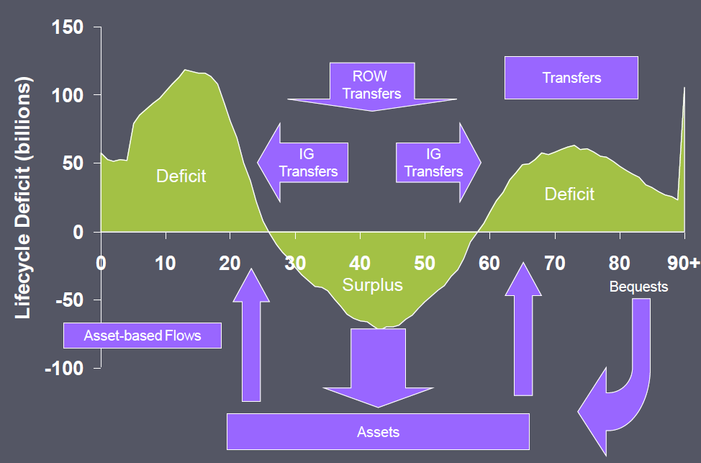
The Generational Economy
(NTA; Mason, A. 2010)

Slide 4
1) Economic lifecycle and reallocation systems
  – Reallocation is facilitated by institutions and mechanisms
    ^{• Transfer systems}
      – Private (families, non‐profits)
      – Public (government mandated programs)
    • Assets that can act as a store of value over time
2) Age and the individual perspective
  – NTA classifies economic flows by age of the individual
  – Individuals receive inflows and give outflows, with saving ^{as the balancing item}
  – Challenges to the individual perspective
    • Institutions are just agents, so NTA must make assumptions to attribute all flows through institutions to individuals
    ^{• Measurement}

Slide 5
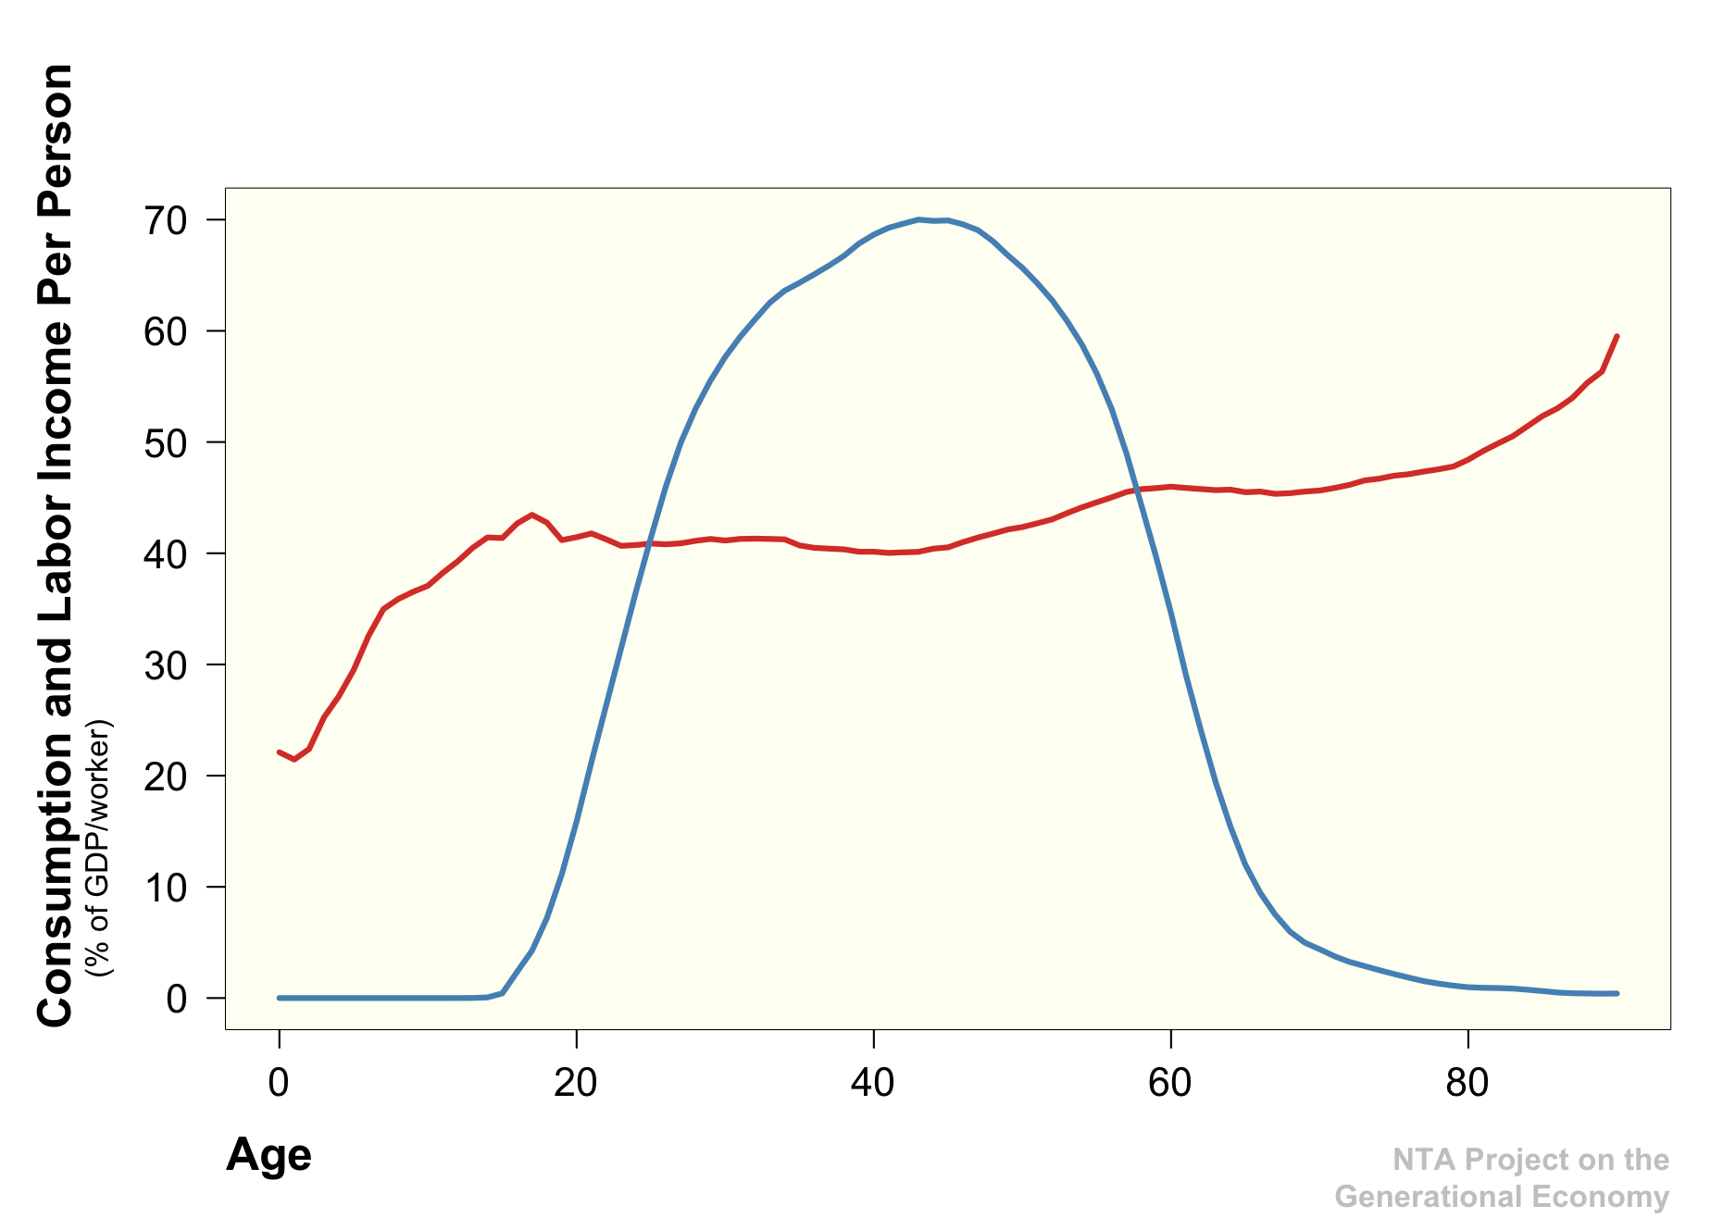
Ingreso laboral
Consumo
Familia, Estado, Mercado
Familia, Estado, Mercado

Slide 6
NTA Flow Identity
Inflows
  Labor Income
  Assets Income
  In-Transfers
Outflows
  Consumption
  Savings (residual)
  Out-Transfers

Slide 7
Organización de las cuentas (Bixby, L.R)
Transferencias tienen flujos de entrada y salida
Salidas en públicas son los impuestos.

Slide 8
NTA and SNA (System of National Accounts);
¹⁾ ^{Consistencies}
^{• Main aggregates}
• NTA uses amounts from SNA as aggregate controls
²⁾ ^{Differences}
• Institutional versus individual perspective
• Some NTA flows do not have SNA counterparts
³⁾ Could be combination of SNA amounts (e.g. NTA labor income combines parts of SNA compensation of employees and mixed income)
⁴⁾ Could be a wholly NTA concept and have no SNA counterpart (e.g. intra‐household transfers)

Slide 9
Global Age Transition
Need for NTA is great because of rapid changes in population age structure.
Low income countries: Share of children in decline and share in working ages is rising
High income countries: Share in working‐ages is in decline and share of elderly is rising.

Slide 10
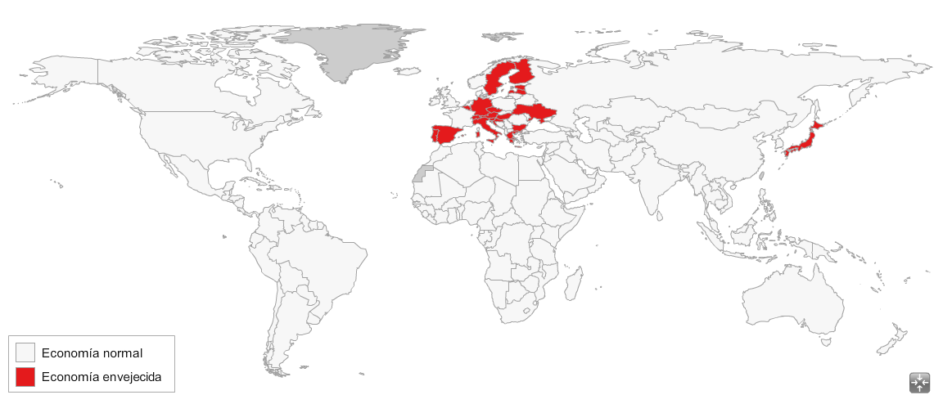
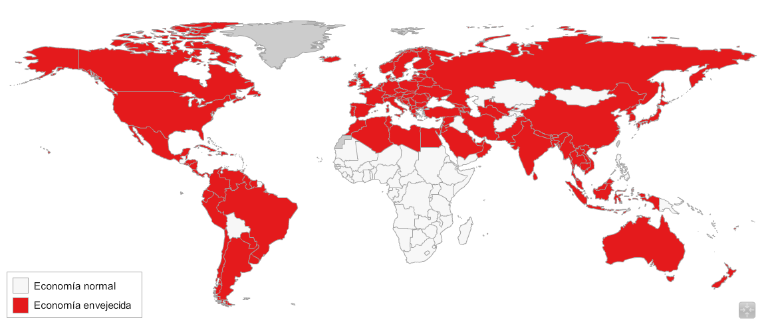
Emergence of Aged Economies (Miller T.)
Today: 19 Aged Economies
2070: 129 Aged Economies
Aged Economy:
An economy in which aggregate consumption by older persons
exceeds that of children.

Slide 11
The Situation We Face Today:
Unprecedented change
Limited and incoherent economic data

Slide 12
Value of National Transfer Accounts
(www.ntaccounts.org, Lee and Mason)
Fundamental question: how do different age groups, including children and the elderly, acquire and use economic resources?
How are access and use to resources influenced by changes in population age structure:
  demographic dividends and economic growth?
  generational equity?
  gender equity?
  financial markets and asset prices?
  sustainability of public and private support systems?
What policies should be considered to best prepare for coming demographic change?

Slide 13
Gap in National Statistical Systems
System of National Accounts and other aggregate economic data provide little information about how different generations or age groups produce, consume, share, and accumulate economic resources.
National Transfer Accounts fills this gap.

Slide 14
Age Reallocations in Japan, 2004
Annual aggregate flows

Slide 15
Shares of consumption not covered by labor income: Family Transfers, Public Transfers and Asset income (part not saved) sum to 1.0
IN
MX
US
CR
DE
BR
CN
SI
HU

Slide 16
Two Demographic Dividends
First Dividend: During the demographic transition, population change leads to a rise in the number of effective workers relative to the number of effective consumers, the dividend phase.
Second Dividend: During and after the dividend phase, population change leads to a rise in worker productivity
  through saving and investment
  through education

Slide 17
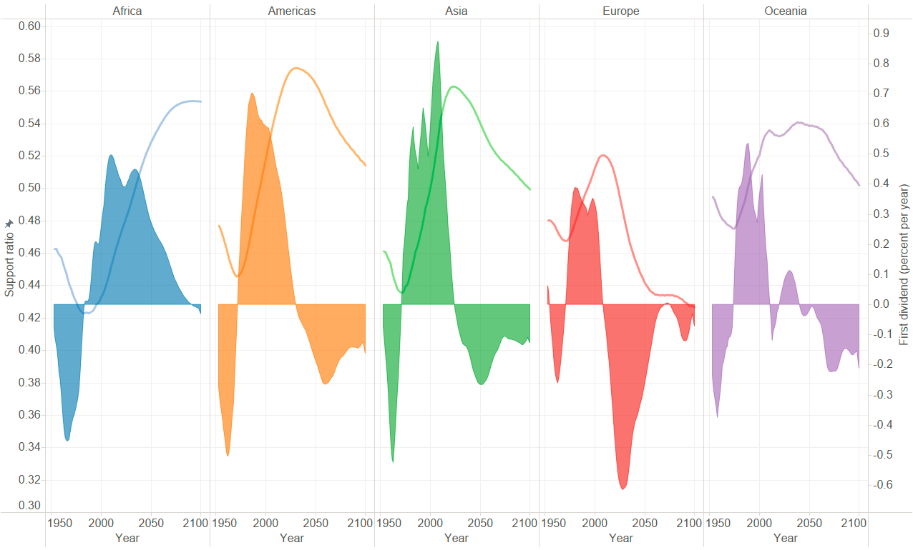
Support ratio and first dividend, major regions of the world, 1950-2100
Note: Unweighted averages of national estimates.

Slide 18
Fertility and pubic plus private human-capital investment per child (relative to labor income)

Slide 19
Average number of daily hours in housework and unpaid care by age, sex and income decile. Brasil, 2013
Fonte: elaborado a partir da PNAD 2013, dados corrigidos

Slide 20
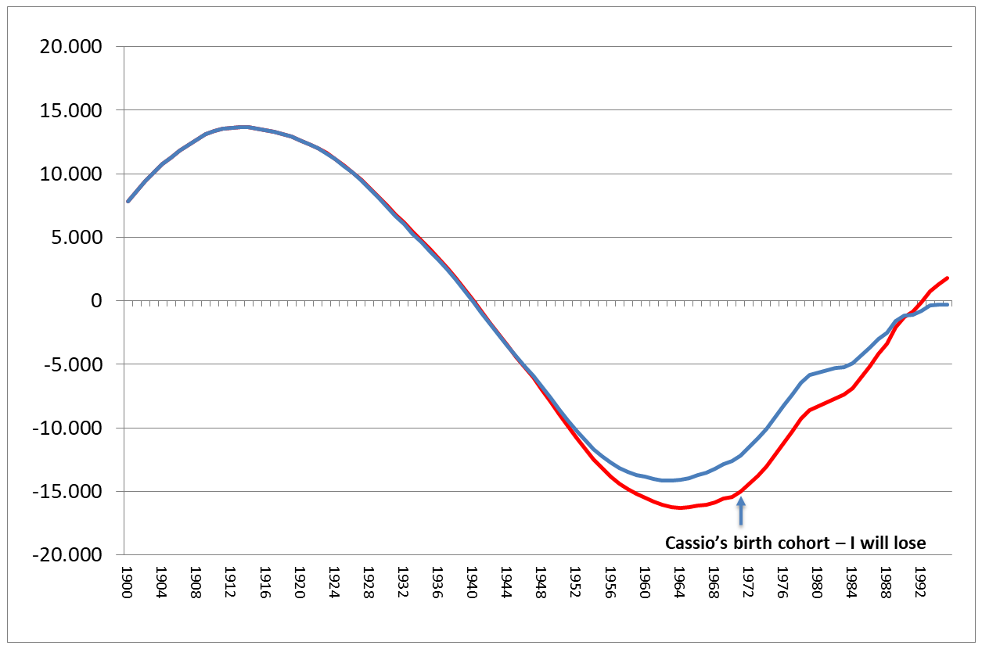
Net Present Value of Public Transfers at Birth
Cohorts born between 1900 and 2000
raise taxes
cut benefits
Turra, Fernandes, Rios-Neto 2018

Slide 21
Opportunities and Challenges of Population Aging in Latin America and the Caribbean

Slide 22
1st Act: The Opportunities (1970-2030)
> labor force first dividend: increasing ratio of producers per consumers
+ gender bonus
+ education bonus
> fiscal support ratios
Most of them are temporary! Almost over in LAC!

Slide 23
Demographic Transition:
intense but short temporary benefits
Total Dependency Ratio (0-14; 65+): High-Income x LAC
challenges ahead
potential gains
UN (2017)

Slide 24
1st Demographic Dividend (% year):
During 1970-2000, LAC experienced the largest potential effect across regions
Mason (2005)

Slide 25
A strong demographic effect (>0.6% year) is the main force behind the 1st dividend
Mean variation (% year) of Total Dependency Ratio (0-14; 65+)
UN (2017)

Slide 26
The gender bonus has added duration and intensity to the 1st dividend,
but losing momentum
Female ecomomically active population (% of total EAP)
CEPAL (2008)

Slide 27
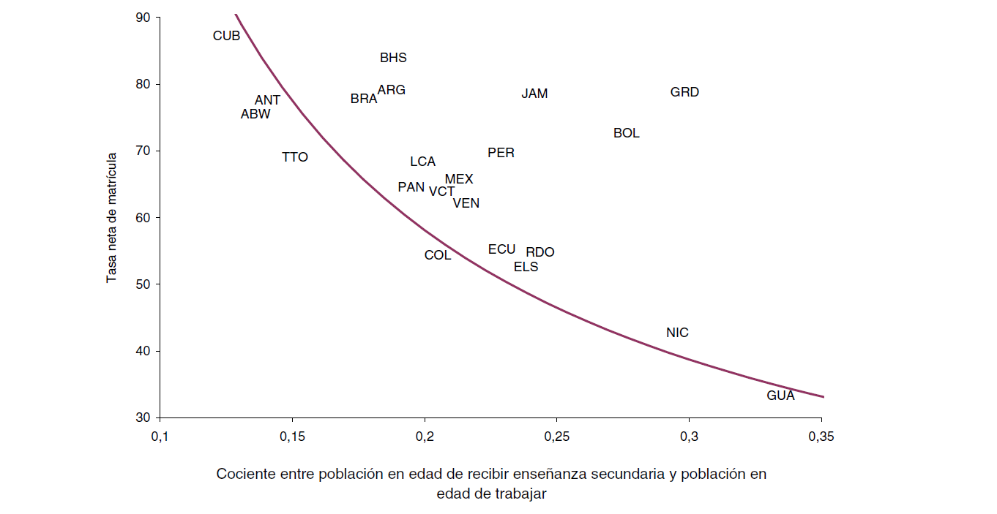
The education bonus has also contributed to the 1st dividend through higher LF participation rates and income, but it is incomplete
Education bonus:
net enrollment rate (secondary) x
dependency ratio for the school age population (secondary)
CEPAL (2008)

Slide 28
2nd Act: The Challenges (2030 - )
< labor force gender bonus (?) education bonus (?)
< fiscal support ratios
The first dividend will be over. The second dividend (larger Y/L) is uncertain

Slide 29
Demographic Transition (2):
rapid population aging
Old-Age Dependency Ratio (65+): High-Income x LAC
From less than half to relatively larger pop 65+ than HI
UN (2017)

Slide 30
1st +2nd Demographic Dividends (% year):
so far, we have failed to transform all potential
into actual growth (1970-2000)
Mason (2005)

Slide 31
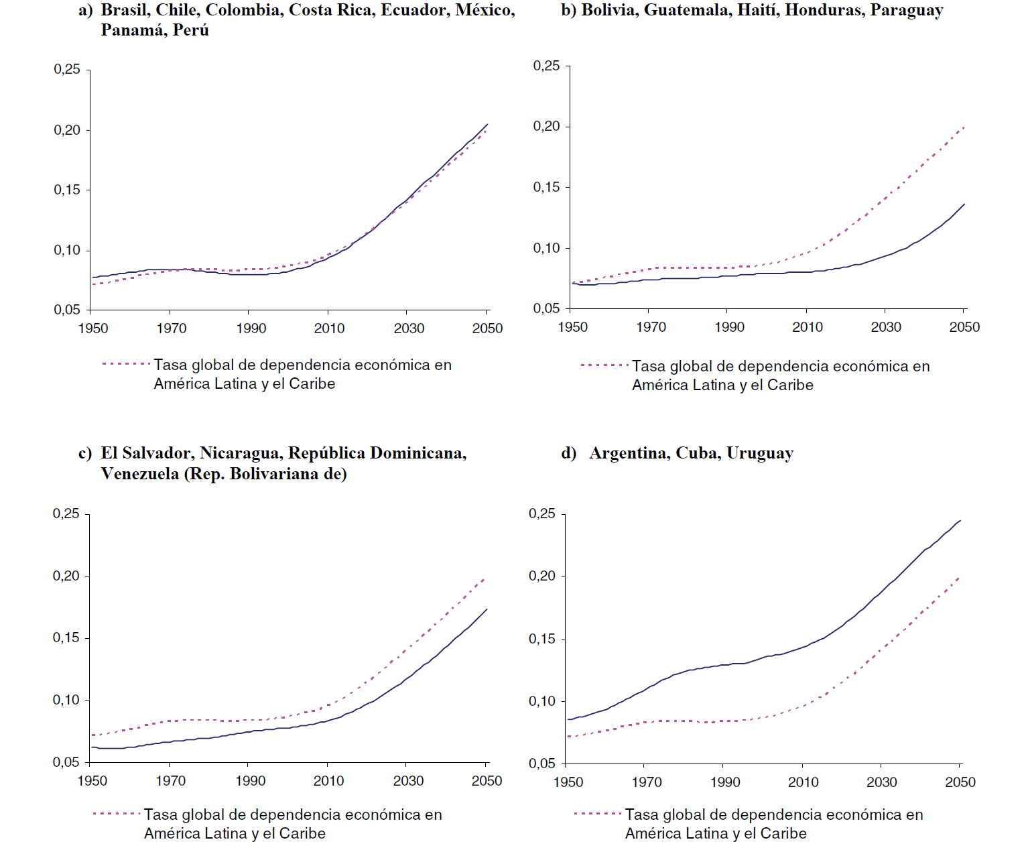
We should expect lower economic growth with a larger burden to finance elderly consumption
Increasing ratio pensioners/producers
CEPAL (2008)

Slide 32
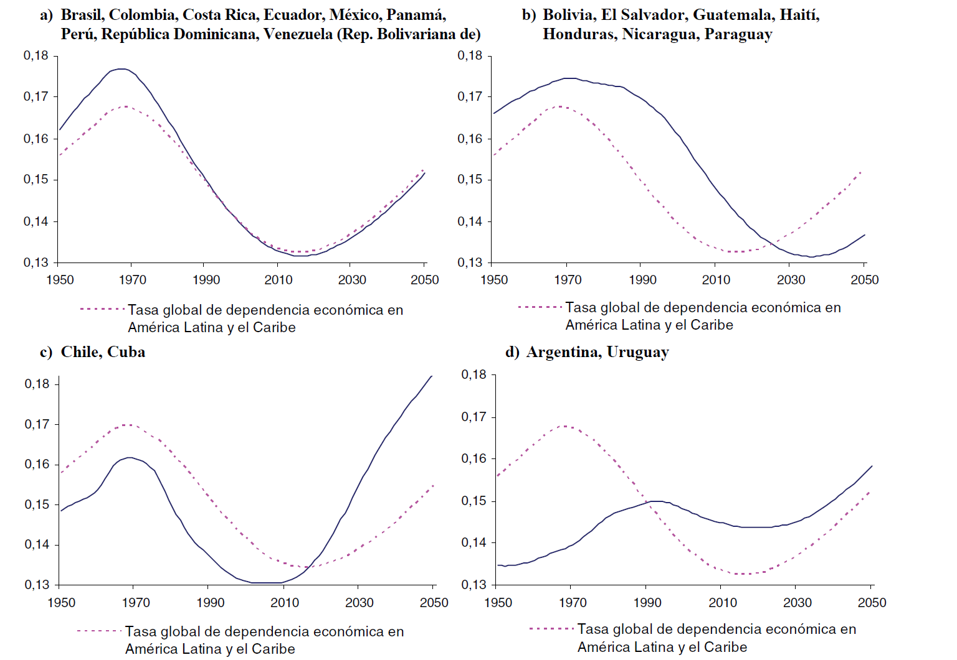
We should expect lower economic growth with a larger burden to finance elderly consumption
Increasing ratio health-care users/producers
CEPAL (2008)

Slide 33
For many countries, the year of most favorable age structure for public transfers is past
Deteriorating Fiscal Support Ratios
Country | 1950 | 2020 | 2050 | Year most favorable
Brazil | 1.00 | 0.94 | 0.86 | 2000
Chile | 0.94 | 0.93 | 0.72 | 2004
Costa Rica | 0.89 | 0.97 | 0.76 | 2012
Mexico | 0.85 | 1.02 | 0.86 | 2019
Uruguay | 1.08 | 1.00 | 0.90 | 1959
Miller (2011)

Slide 34
Achieve faster productivity growth:
- better quality of education
- technology absorption
- more efficient allocation of resources (economic sectors)
Mitigate labor force reduction:
- better quality of education
- larger investment in health at younger/adult ages
- promote international migration to the region
- redefine age at retirement
- promote gender equity
- reduce inequalities or population aging will be a big challenge in LAC very soon!

Slide 35
El doble desafío (Miller, T)
Cuentas Nacionales de Transferencias pueden ayudar a enfrentar el doble desafío de nuestra región: el envejecimiento de la población y la desigualdad ...
... mediante la medición de las relaciones económicas dentro de una economía nacional: entre jóvenes y adultos mayores, entre ricos y pobres, entre hombres y mujeres.

